Slide 1
Meta-Reports: a Bird’s Eye View of Operational Data at UMBC
Saydeh Karabatis
Division of Information Technology
University of Maryland, Baltimore County (UMBC)

Slide 2

Presented at
Higher Education User Group
Mid Atlantic Regional HEUG
Coppin State University,
Baltimore, MD
June 2, 2015

Slide 3
Outline
UMBC at a Glance
REX at a Glance
Power of Data
Meta-Reports
Examples

Slide 4
UMBC at a Glance in 2014
President Dr. Freeman A. Hrabowski
Student Enrollment
Employees
Undergraduate 11,379
Graduate 2,600
Total 13,979
Faculty
Full-time 520
Part-time 265
Staff 1,289
Total 2,074
Programs
Undergraduate
Majors 42
Minors 41
Certificates 17
Graduate
Masters 37
Doctoral 24
Certificates 24
Freshman Class Profile
SAT Average 1214
Grade Point Average 3.78
Living on Campus 72%
19 NCAA Division I Sports
Carnegie Classification – Research Universities (High Research Activity)

Slide 5
Outline
UMBC at a Glance
REX at a Glance
Power of Data
Meta-Reports
Examples

Slide 6
Report EXchange (REX) at a Glance
REX, a reporting and decision support environment for UMBC’s data warehouse that allows users to report and analyze University data for administrative purposes.
2006: UMBC purchased a data warehouse product from a local company, iStrategy. The product loads data from PeopleSoft Student Administration (PSSA) into a set of SQL Server tables designed to facilitate reporting (came with many delivered reports)
2007: Converted critical legacy data into a “virtual” PSSA database, thereby getting the warehouse and its reporting tool to work
2009: Went live with PeopleSoft Student Administration (Recruitment, Admissions, Financial Aid, Registration and Student Billing). Branded the data warehouse as REX
2010: Converted census data from 1995 to present into data warehouse. Implemented Finance Module
2012: Implemented Learn Analytics Module using Blackboard data

Slide 7
REX by Numbers

Slide 8
Outline
UMBC at a Glance
REX at a Glance
Power of Data
Meta-Reports
Examples

Slide 9



The Power of Data
01010101
User activities → enormous information
Data: one of the most important assets of any organization
Decisions are made depending on what type of information is made available
Un-harvested data = unchecked book collecting dust
01010101
01010101
01010101
01010101
01010101
01010101
01010101
01010101
UMBC gathers data related to faculty, staff, and students and stores it in PeopleSoft
Nightly extract from PeopleSoft → SQL-Server
Reports are written over the data to show various aspects of the university to various stakeholders

Slide 10
Outline
UMBC at a Glance
REX at a Glance
Power of Data
Meta-Reports
Examples

Slide 11






What is Meta-X?
Meta-Data
Meta-Jokes
Meta-Programming

Slide 12
Five Ws and Two Hs of Meta-Reports
Why? Better decision making from stakeholders
What? Capture activities as much as possible
When? Current and ongoing
Where? Data Warehouse - SQL Server
Who? Input from several IT members
How? Numerous reports are implemented
Happy? Yes

Slide 13




Why are Meta-Reports useful?
Monitor Report usage
  Who is using the reports
  At what time (often, periodically, rarely)
  Execution time; fine tuning the underlying code
Better decision making from stakeholders
(Managers, Administrators, Department Chairs, etc.)
Monitor the system/network and identify
bottlenecks
Give thorough insight on the usage of the reporting environment of any organization. Respond better to user requests

Slide 14
Meta-Reports at UMBC
REX Activities: Bird’s Eye View by
  Division and Department
  User Activities
  Report Usage
Most or Least … Within a Date Period
  Active Departments
  Active Users
  Popular Reports
  Interactive Reports
  Subscribed Reports
  Recently Executed Reports

Slide 15
Outline
UMBC at a Glance
REX at a Glance
Power of Data
Meta-Reports
Examples

Slide 16
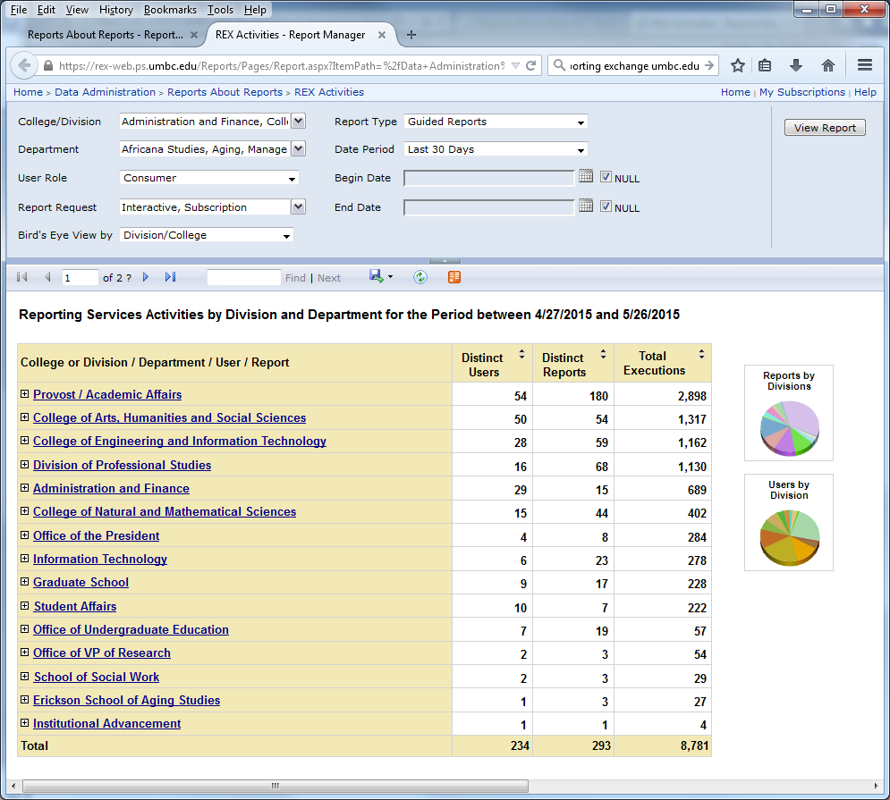
REX Activities by Division and Department

Slide 17
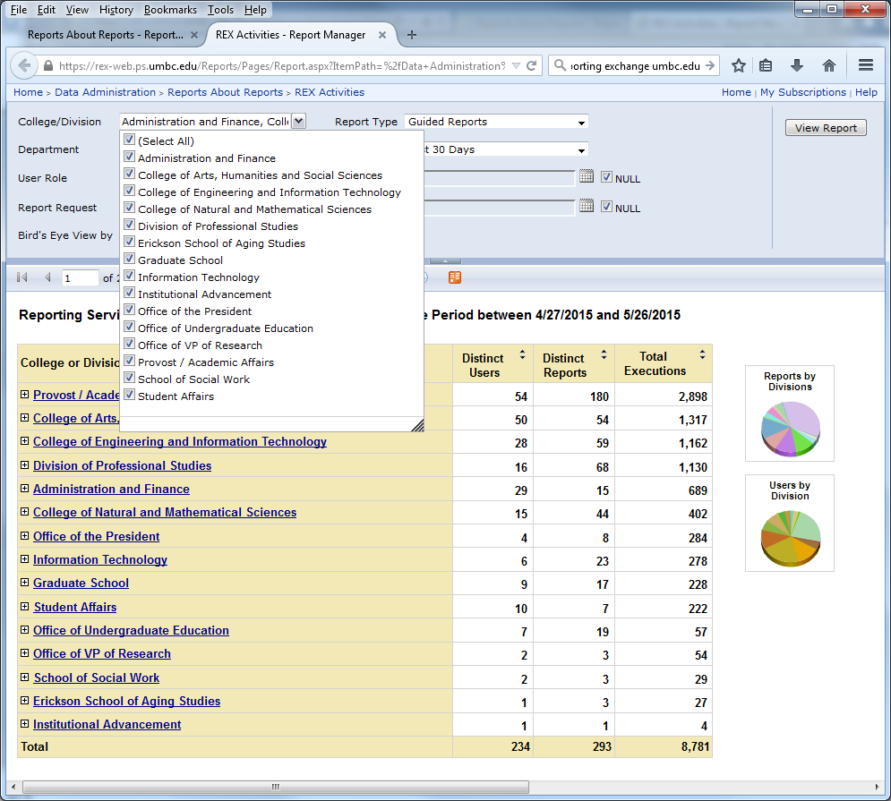
REX Activities: Choose College or Division

Slide 18
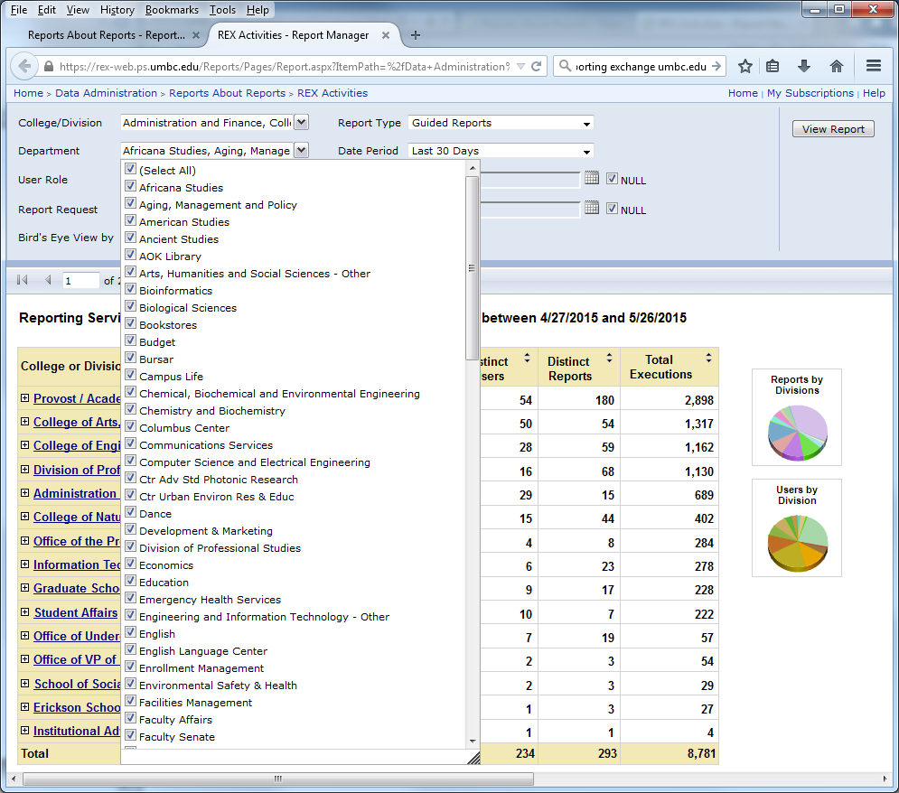
REX Activities: Cascading List of Department Names

Slide 19
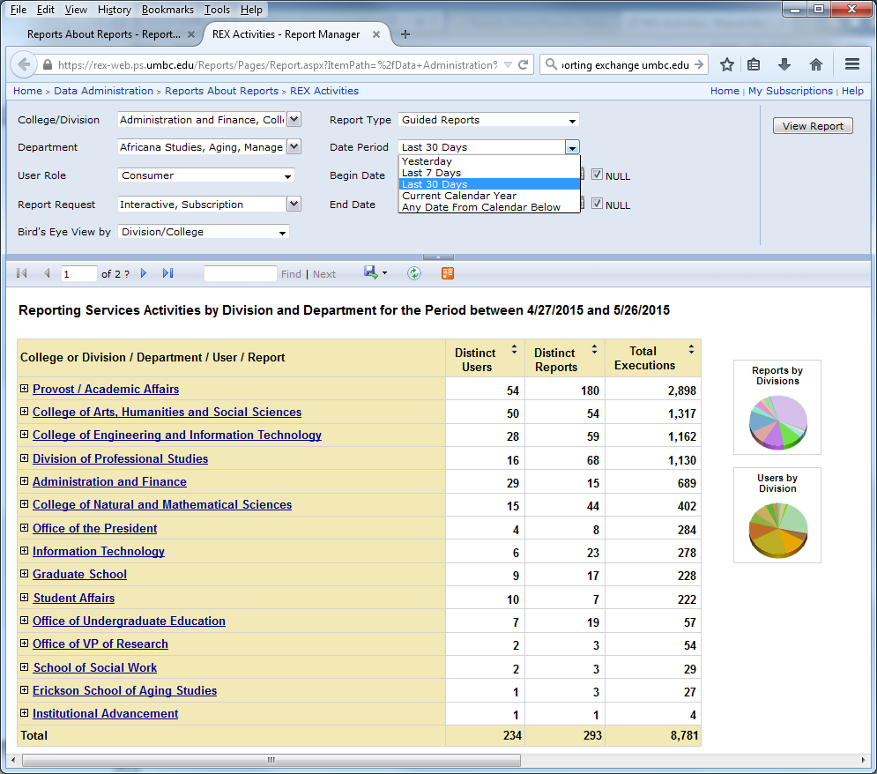
REX Activities: Selecting Date Intervals for Reports

Slide 20
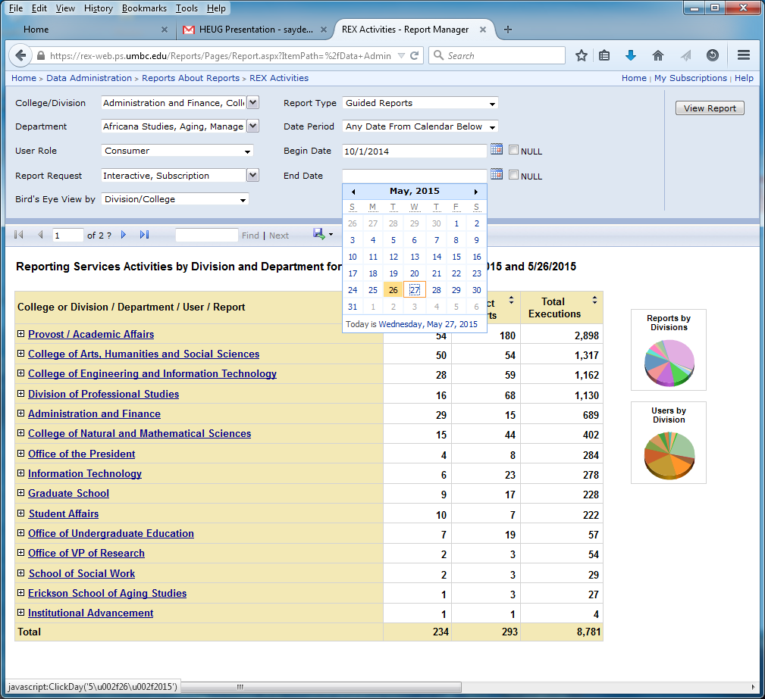
REX Activities: Choosing any Date Range

Slide 21
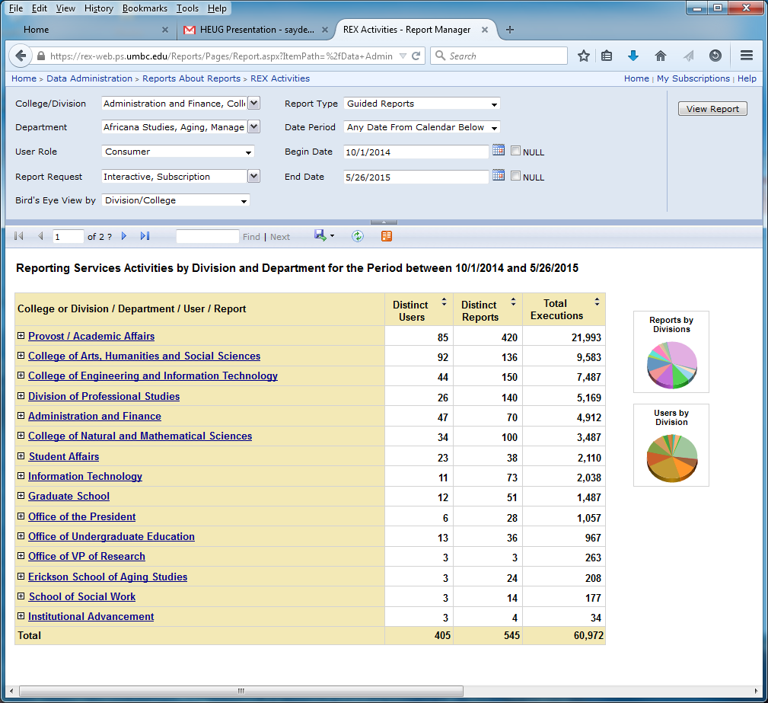

REX Activities: Choosing any Date Range (cont’d)

Slide 22
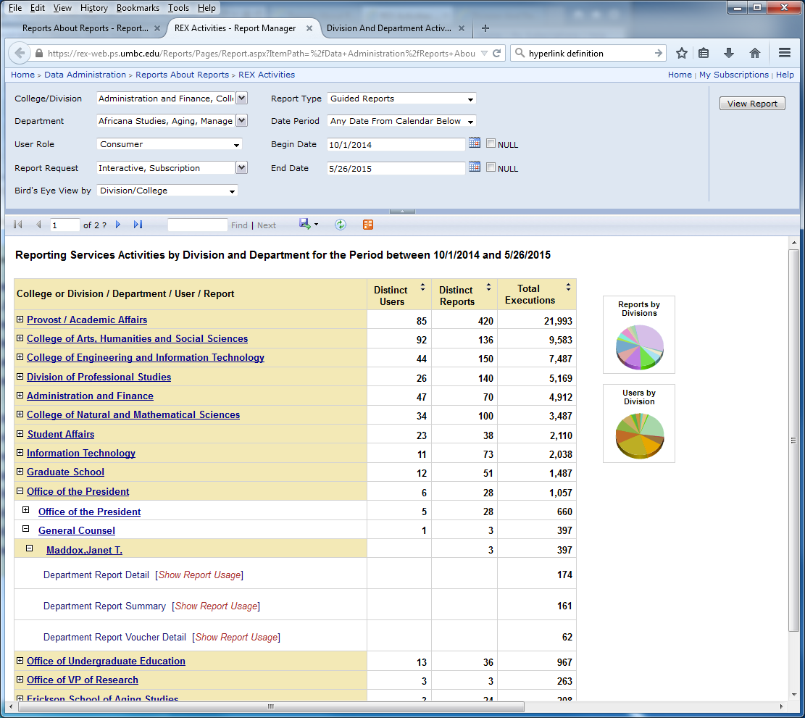
REX Activities: Division → Dept. → User(LDAP)
Ad\jmaddox, Executive Administrative Assistant

Slide 23
REX Activities: Viewing Division Activities

Slide 24
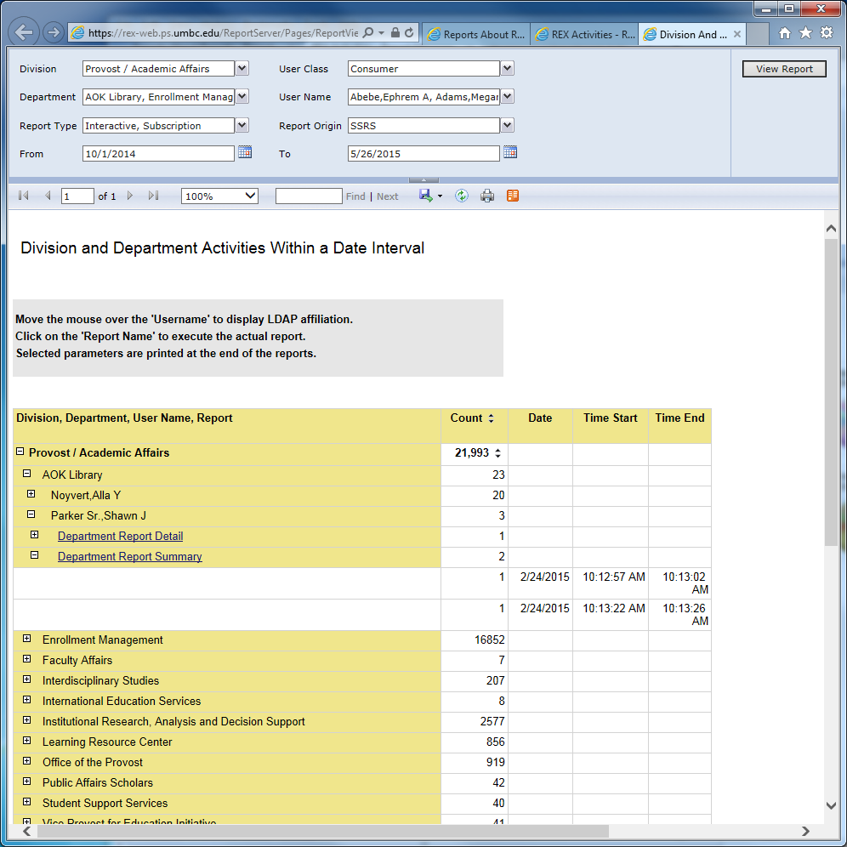
Detailed Division Activities (New Window)

Slide 25
REX Activities: Viewing Department Activities

Slide 26
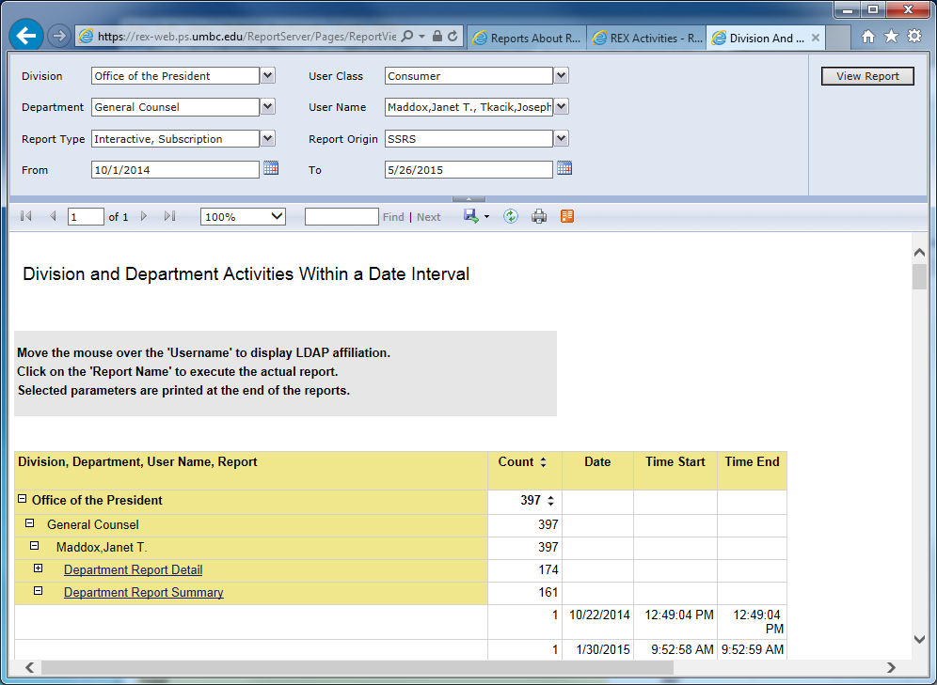
Detailed Department Activities (New Window)

Slide 27
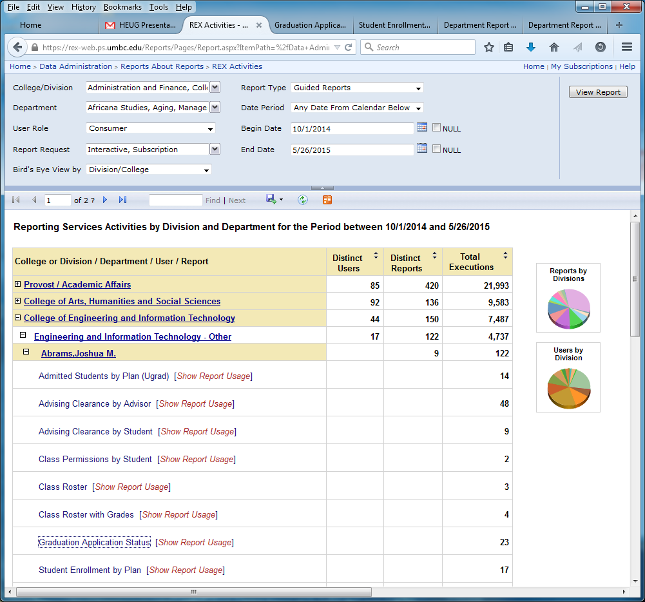
REX Activities: Linking to Initial Report

Slide 28
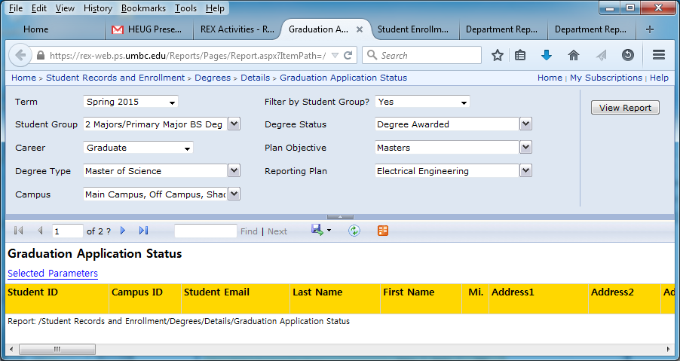
Target Report

Slide 29
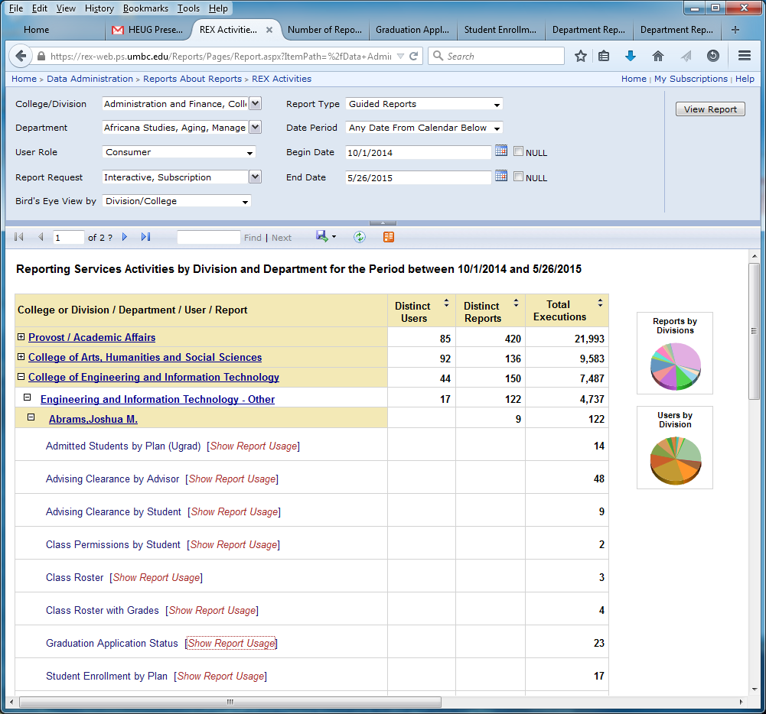
REX Activities: Linking to Report Activities

Slide 30
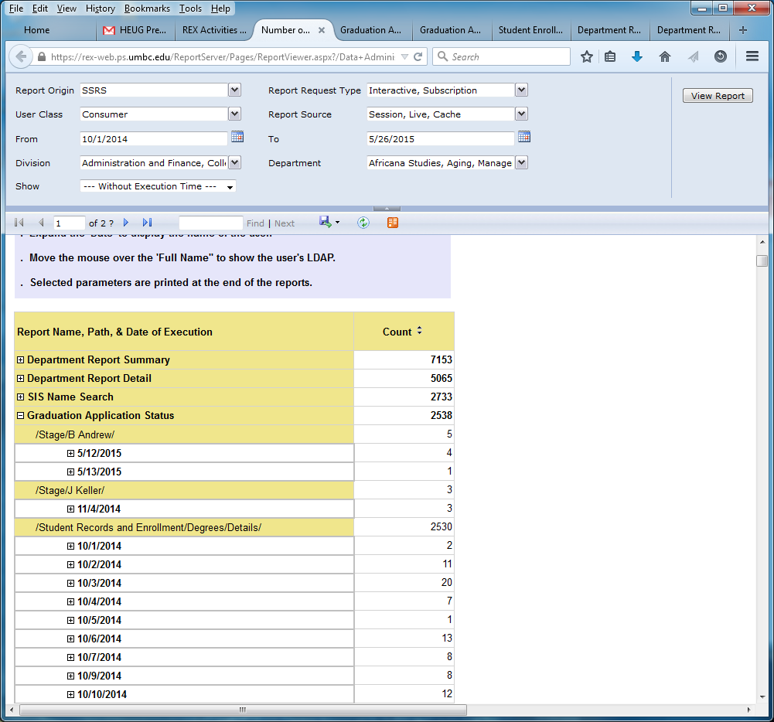
Report Execution Statistics

Slide 31
REX Activities: Graphical Representation

Slide 32
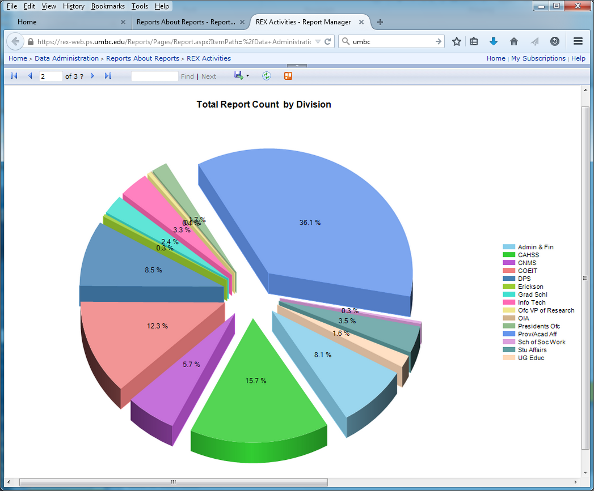
REX Activities: Report Count by Division

Slide 33
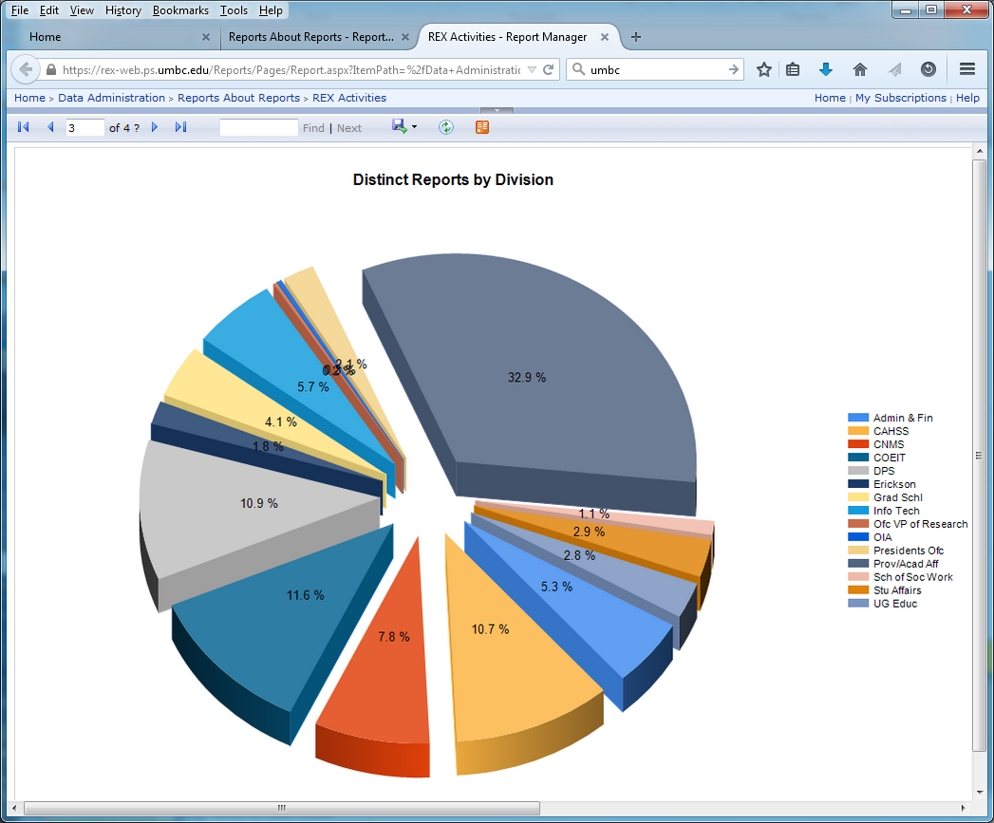
REX Activities: Unique Reports by Division

Slide 34
REX Activities: Graphical Representation

Slide 35
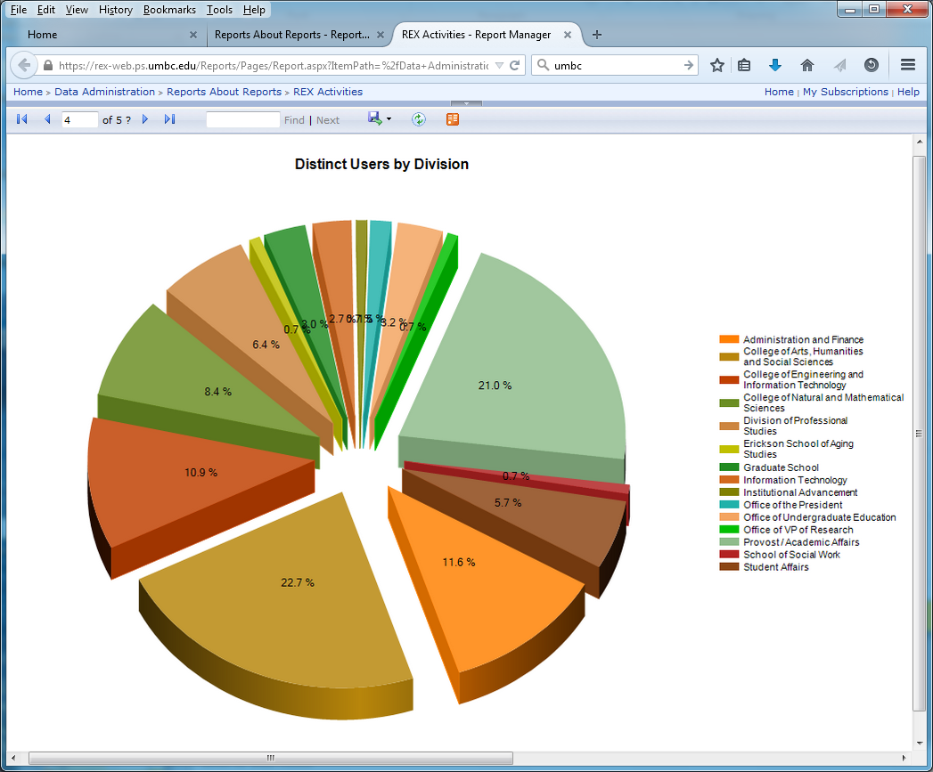
REX Activities: Unique Users by Division

Slide 36
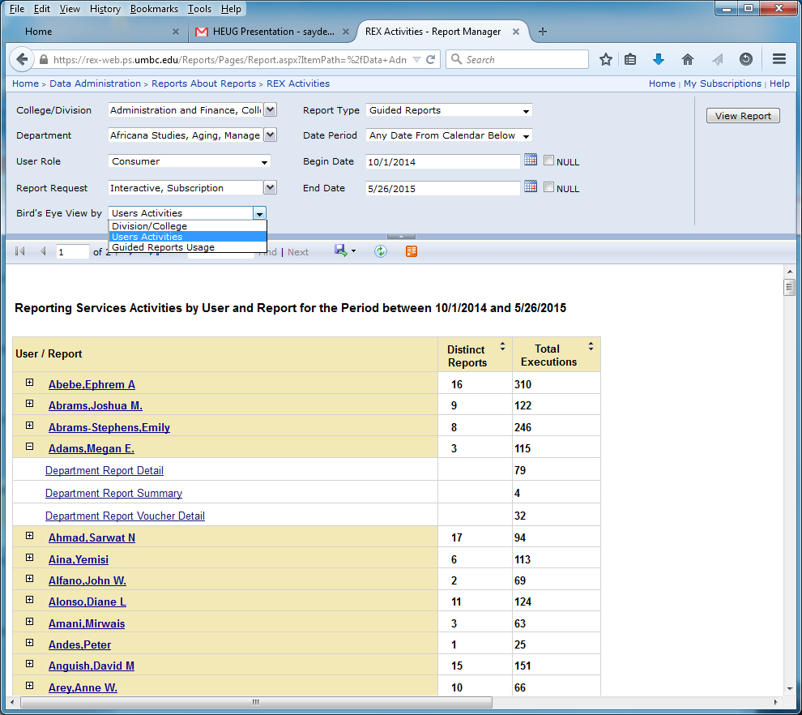
REX Activities: Linking to User Activities
\megan, Coordinator, Women’s Center, Provost and Academic Affairs

Slide 37
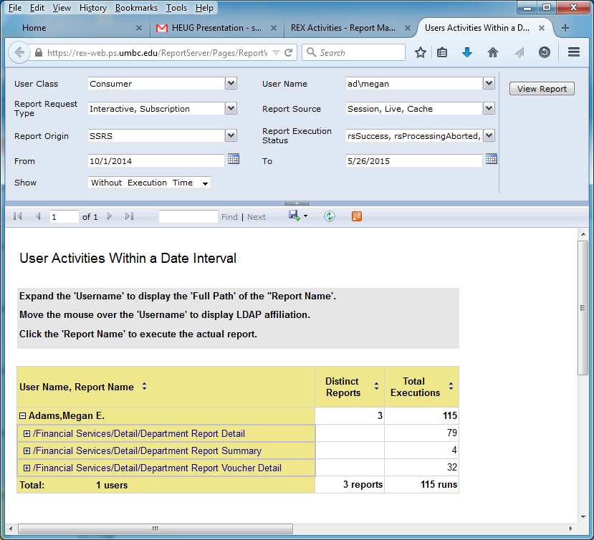
User Activities Within Date Period

Slide 38
Meta-Reports at UMBC
REX Activities; Bird’s Eye View by
  Division and Department
  User Activities
  Report Usage
Most or Least … Within a Date Period
  Active Departments
  Active Users
  Popular Reports
  Interactive Reports
  Subscribed Reports
  Recently Executed Reports

Slide 39
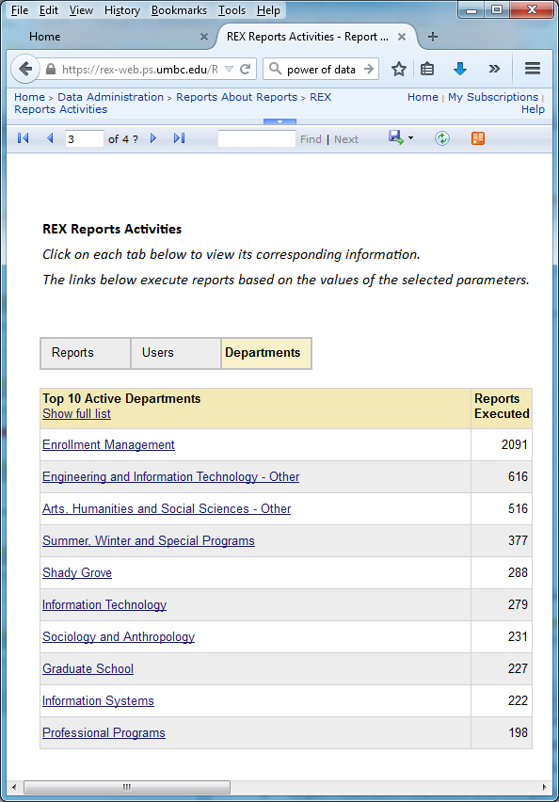
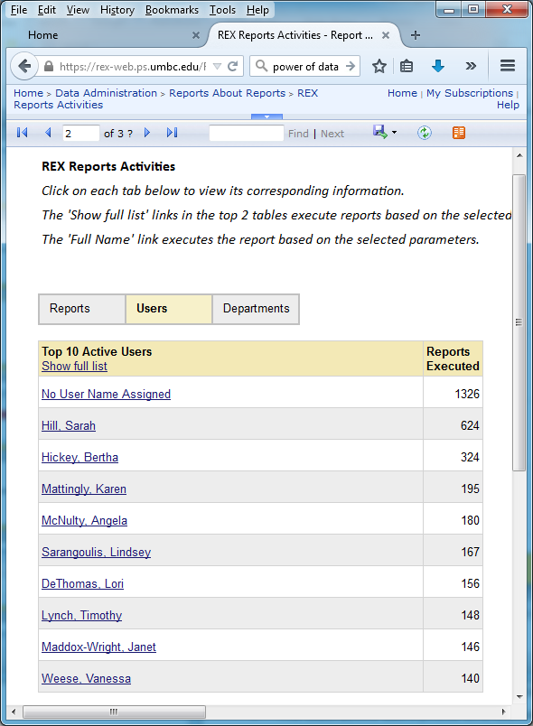
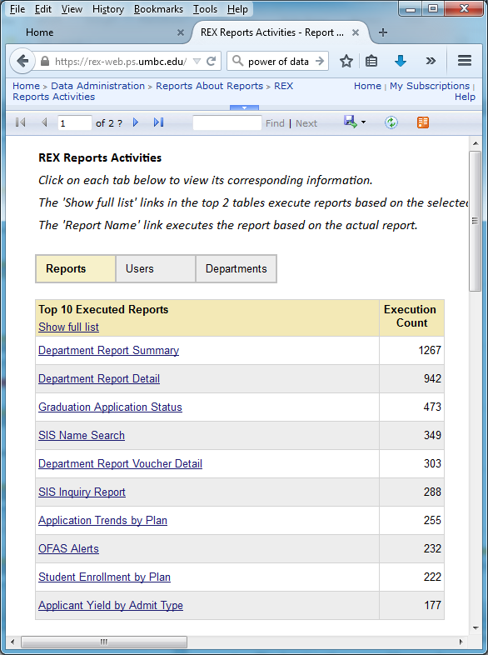
Dashboard-Style Meta-Reports

Slide 40
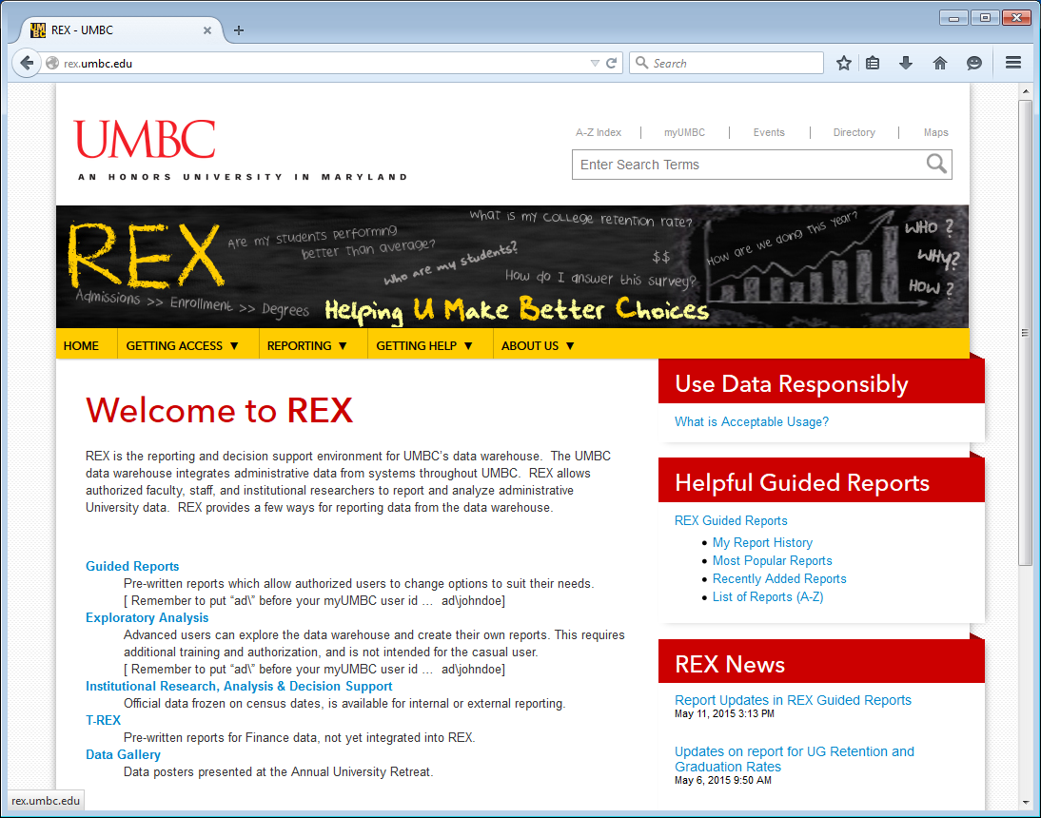
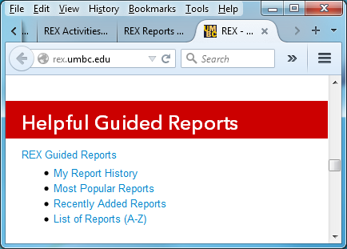
More Guided Reports

Slide 41
Additional Meta-Reports

Slide 42
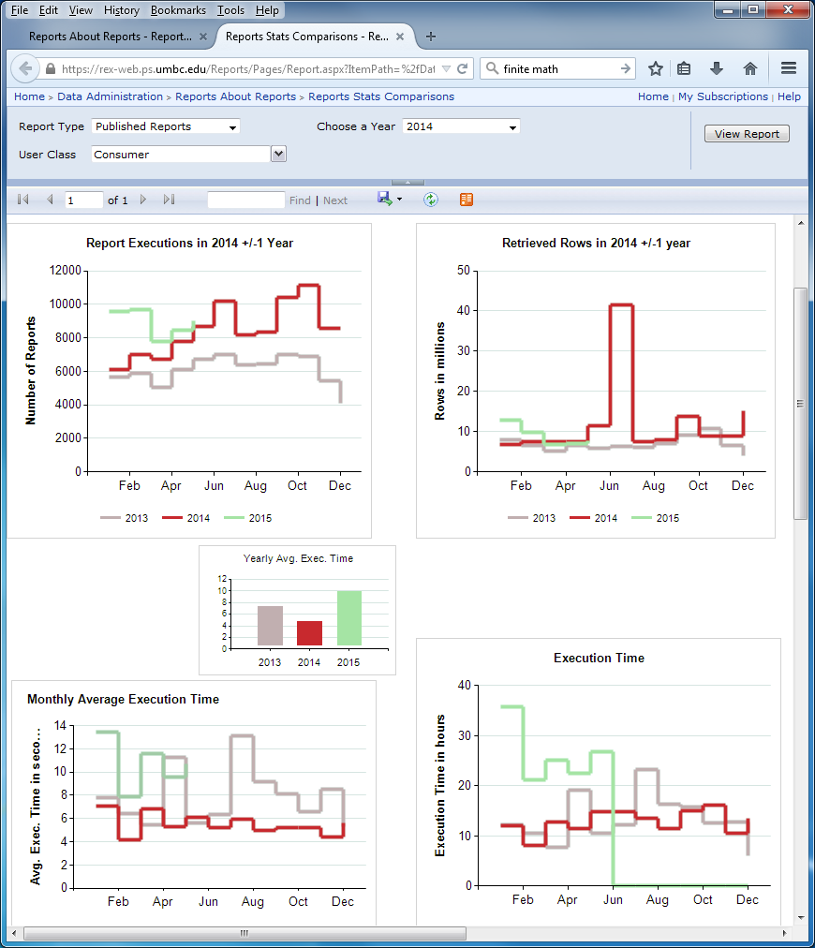
Report Usage Comparisons within 3 years

Slide 43
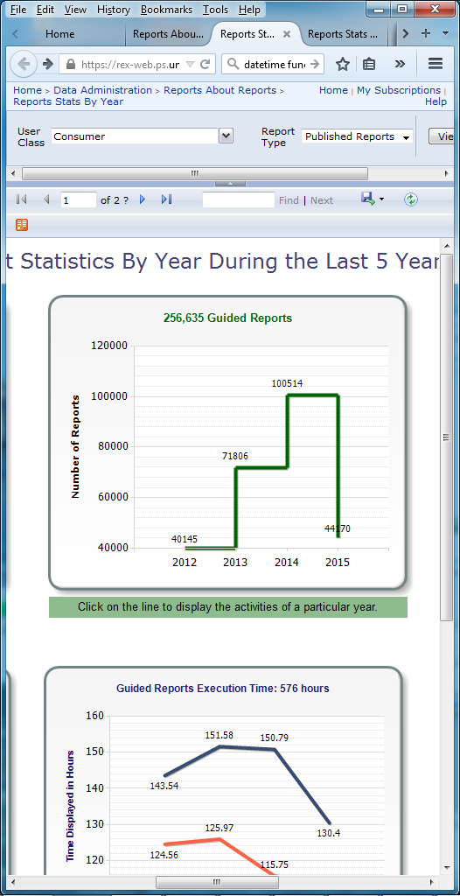
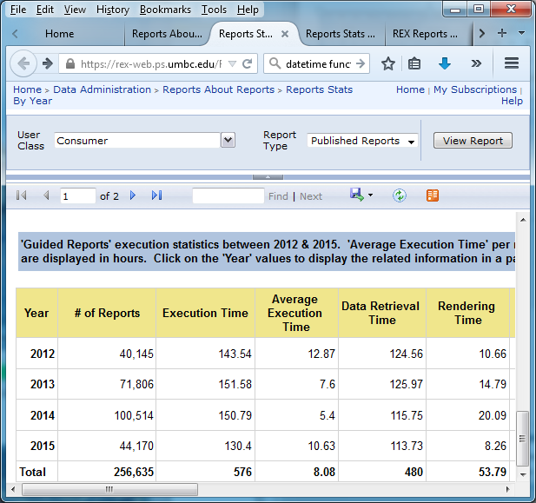

Overall Report Usage by Year

Slide 44
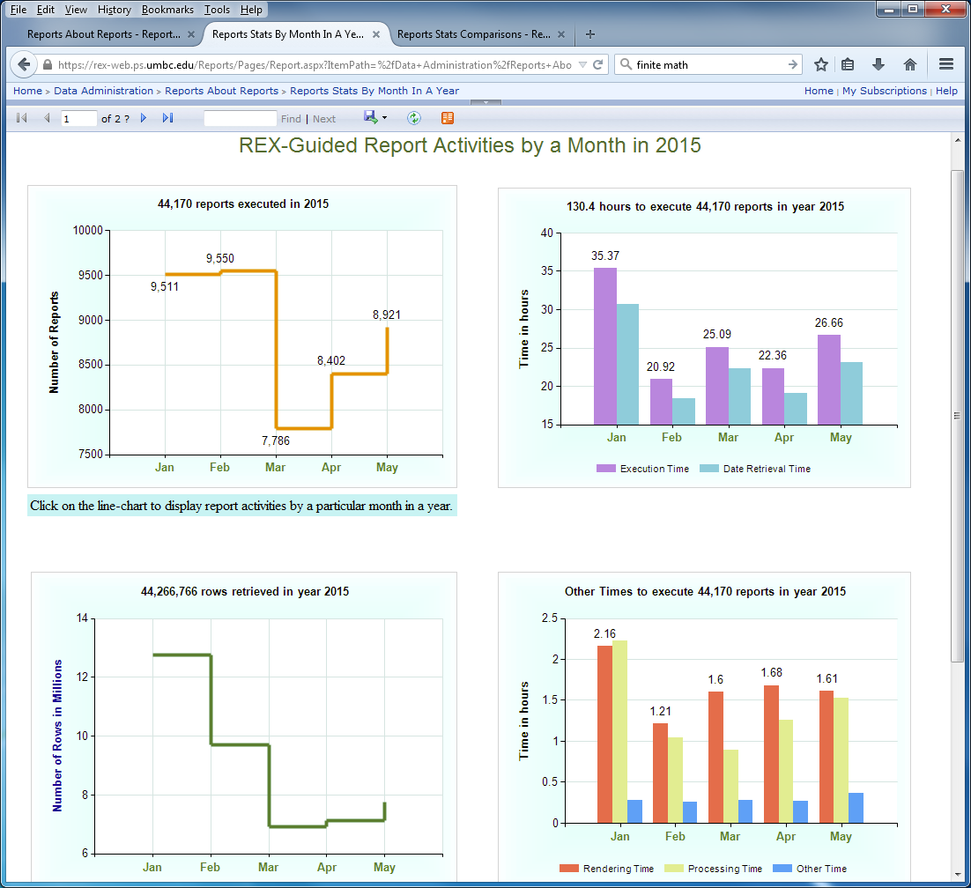
Overall Report Usage by Month in a Year

Slide 45
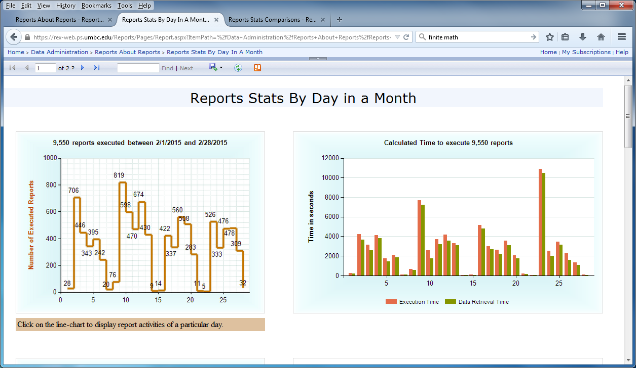
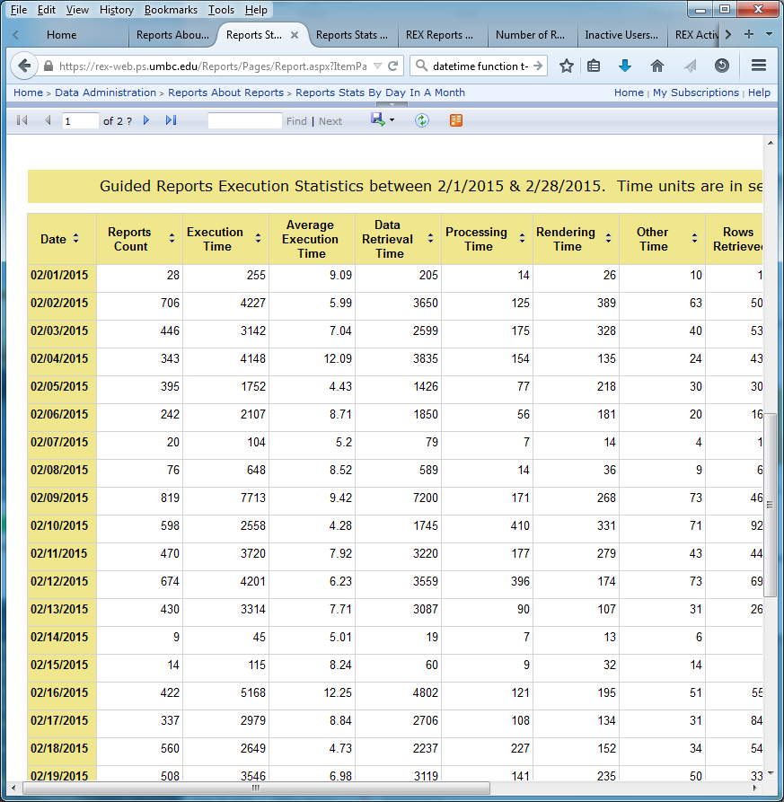
Overall Report Usage by Day in a Month

Slide 46
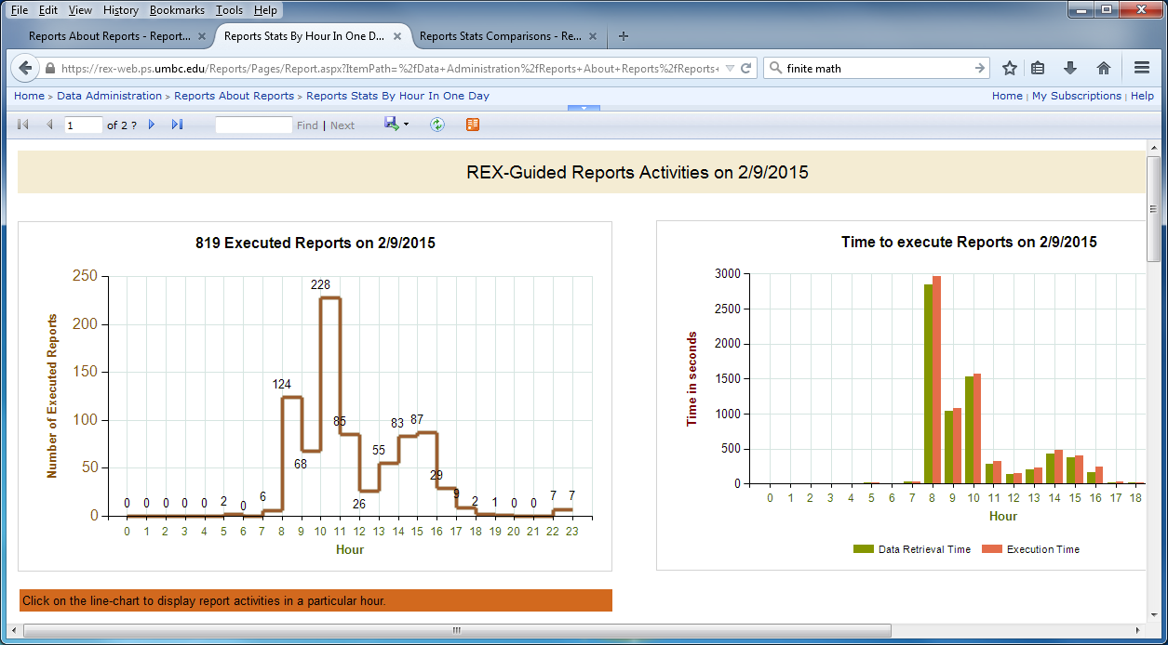
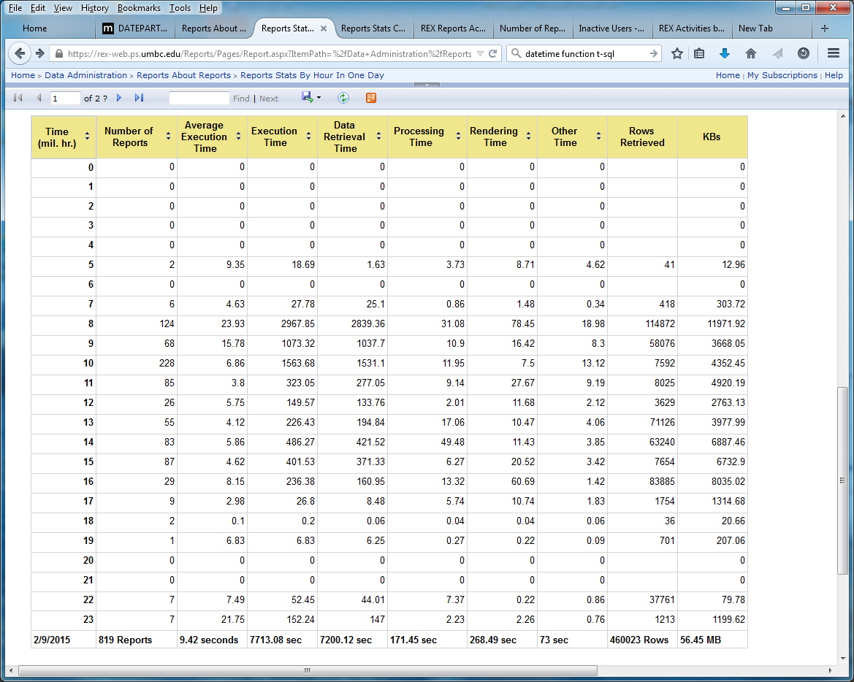
Overall Report Usage by Hour in a Day

Slide 47
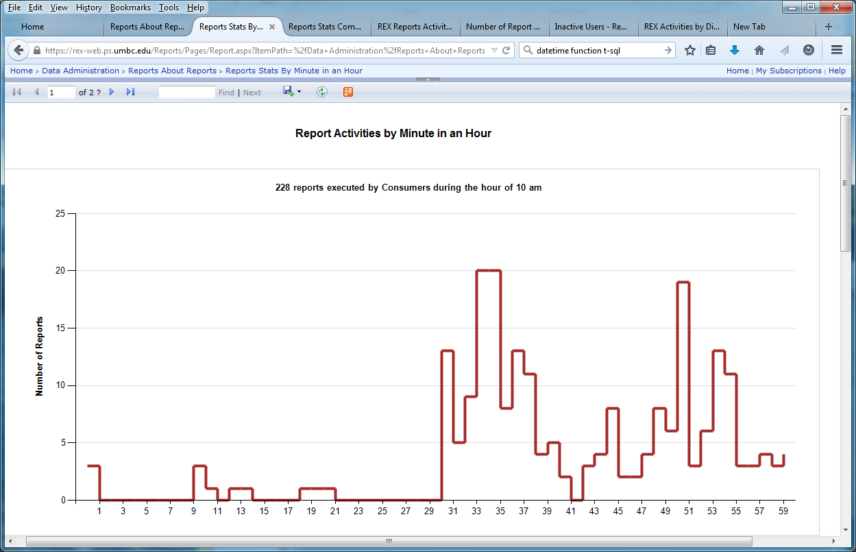
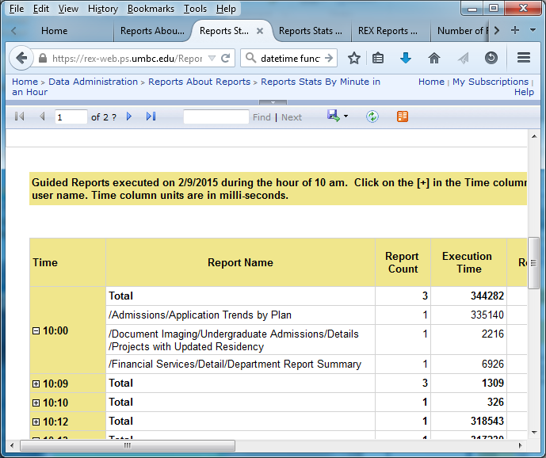
Overall Report Usage by Minute in a Hour

Slide 48

Questions?

Slide 49

Thank you!
saydeh1@
umbc.edu

